Slide 1


Adani stock price prediction
Adani stock price prediction

Slide 2

About dataset -
The dataset contains details of ADANI ENTERPRISES LIMITED stocks from 2021 to 2023.
The dataset you provided is related to the stock price of Adani Enterprises Limited (ADANIENT) traded on the National Stock Exchange (NSE) in India.
The data includes the following fields:
->Date: This column represents the date for which the stock market data is being presented.
->Series: This column represents the series of the stock. Stocks can be traded in different series such as equity shares, preference shares, or debentures, among others.
->OPEN: This column represents the opening price of the stock on the given date.
->HIGH: This column represents the highest price at which the stock traded during the day on the given date.
->LOW: This column represents the lowest price at which the stock traded during the day on the given date.
->PREV. CLOSE: This column represents the closing price of the stock on the previous trading day.
->LTP: This column represents the last traded price of the stock on the given date.
->CLOSE: This column represents the closing price of the stock on the given date.
->VWAP: This column represents the Volume Weighted Average Price of the stock on the given date.
->52W H: This column represents the highest price at which the stock traded in the past 52 weeks.
->52W L: This column represents the lowest price at which the stock traded in the past 52 weeks.
->VOLUME: This column represents the total number of shares traded on the given date.
->VALUE: This column represents the total value of shares traded on the given date.
->No of trades: This column represents the total number of trades executed on the given date.

Slide 3
Workflow -
1) Data set loading
2) Data pre-processing - understanding the data and checking data frame of the data, checking if any null values or missing values are there and drop duplicates and doing some visualization to get more insights of the data
3) Doing some eda – checking outliers on numerical column and checking the columns whither normally distributed or not and doing some univariate and bi-variate analysis
4) Feature selection – drop unwanted columns if it is not contributing to model building
5) Applying regression and model construction – importing necessary library and doing train test split
6) Checking algoridum performance through regression metrics –
7) Checking accuracy of model

Slide 4
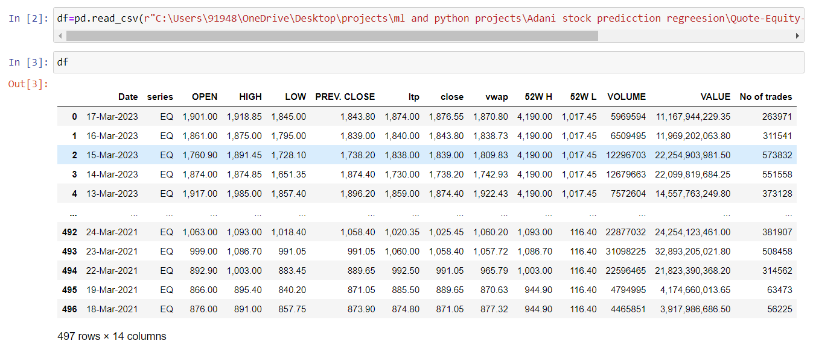
Loading the dataset -

Slide 5
Data preprocessing -
Checking head value
Checking description of the data
Checking datatype of the data and changing the datatype(object to float64)
Checking the shape of the data
Checking null values
Checking duplicate value in the data and many more….
Doing some basic eda -
Univariate analysis -
Checking outliers
Doing normality test
Checking density of the dataset
Bivariate analysis -
Checking the top 10 Adani stock price through bar plot
Checking correlation between the values through heatmap

Slide 6
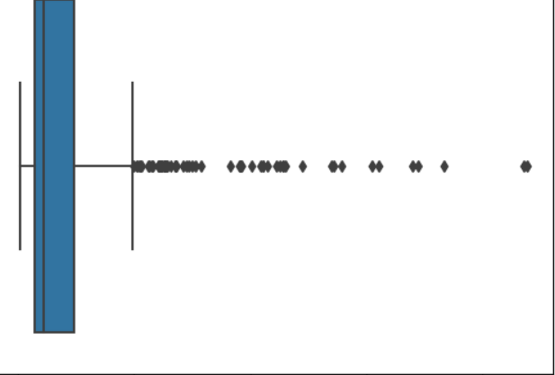
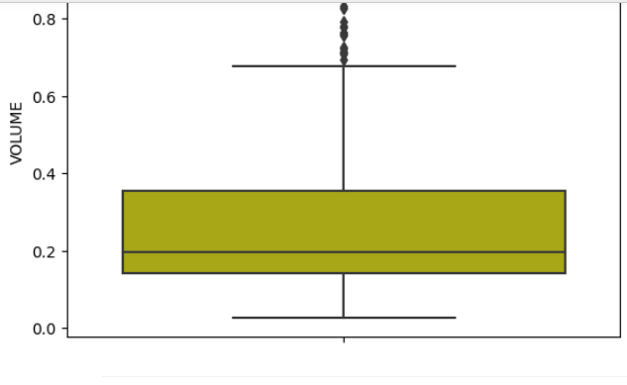
Checking outliers -
In volume and no_of_traders column there are outliers
Removing outliers through method

Slide 7
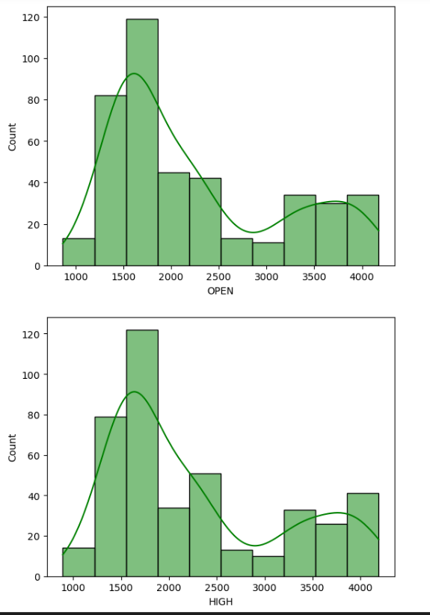
Checking whither data is normally distributed or not -
Some columns are normally distributed but some are left skewed so the columns which are required for model building so we are going to use standard scaler and convert that column into normal distribution

Slide 8
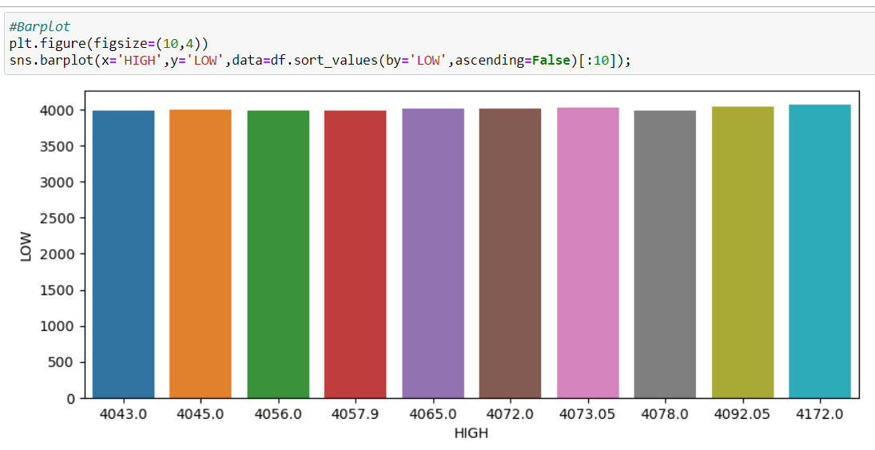
Bivariate analysis -
Checking top ten 10 highest quoted price of per Adani share in the market. In the plot we can see that 4172 and lowest was 4043 this is valuable insights that we drawn from this data

Slide 9
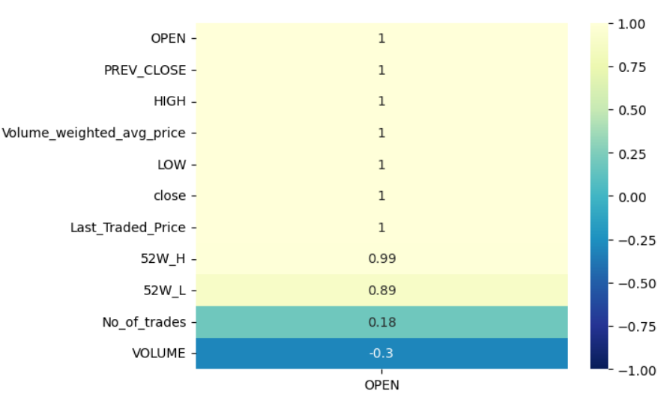
Checking correlation by plotting heatmap -
Here we can see that almost all the values are correlated with each other except volume and no_of _trades column as this column are not much useful for our model building process so we are going to just drop it.

Slide 10

Model building -
So we have taken our target variable as open means market value of Adani company. In the filed of stock market market value plays very important role based upon market value various analysis is done. By seeing market value of the company any investor can judge whither the company is performing well in the market or not so we are taking open price(market value) as our target variable(y)..
Factors that are closely related to market value that we are taking as independent variable(x) that are high low last_traded_price and close

Slide 11
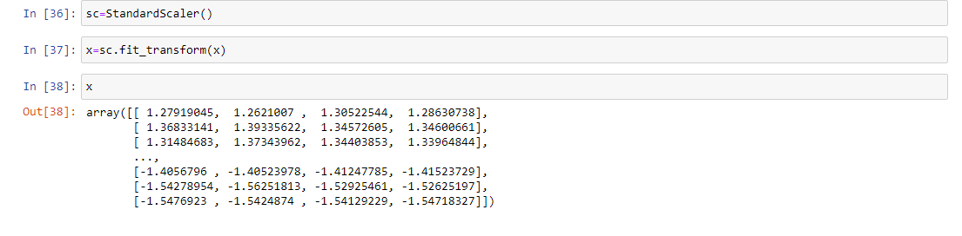
Using standard scaler to shrink our data for better result -

Slide 12
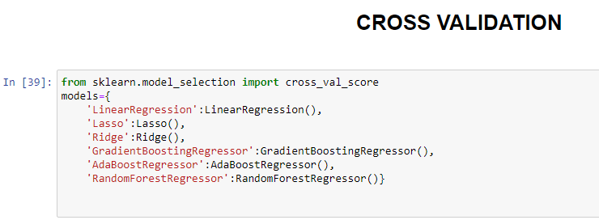
Using cross validation technique -
Here we are using cross validation technique as it will helpful for training data and evaluating the model It will boost the performance of the model..

Slide 13
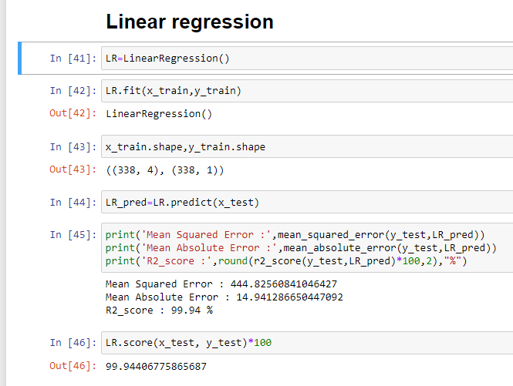
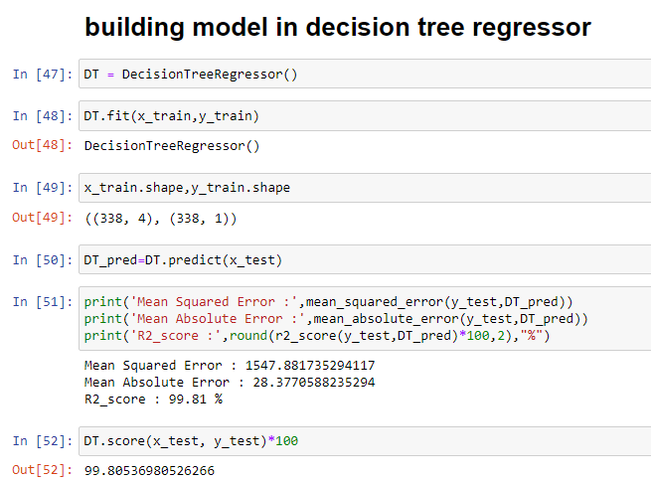
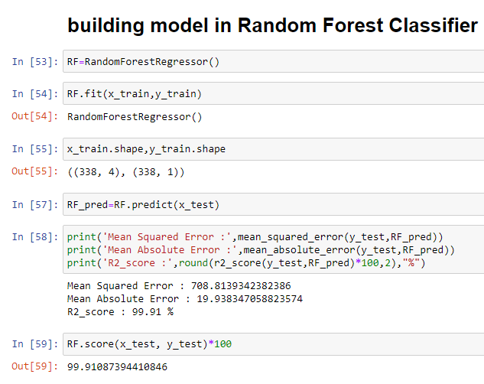
Building model with linear, decision tree & random forest -

Slide 14
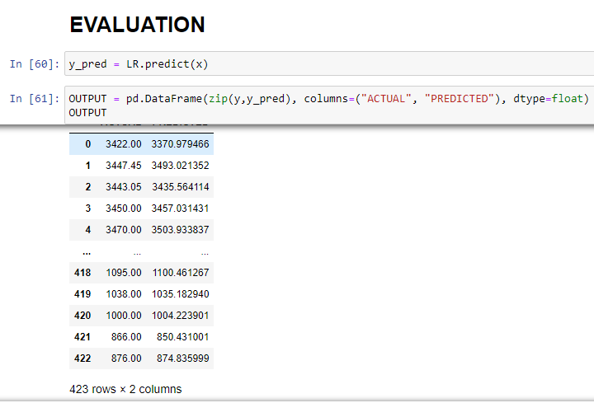
Evaluating model’s performance

Slide 15
Drawing some conclusion -
->Relationship between variables: The regression analysis helps identify the relationship between the independent variables (such as historical stock prices, trading volumes, economic indicators, or sector performance) and the dependent variable (Adani stock price). It provides insights into how changes in the independent variables affect the stock price.
->Statistical significance: The regression analysis provides statistical measures, such as coefficients and p-values, to assess the significance of the independent variables in explaining the variation in Adani stock price. A significant p-value indicates that the variable has a meaningful impact on the stock price.
->Predictive power: The regression model can be used to estimate future Adani stock prices based on the identified relationships. By inputting values for the independent variables, the model can generate predictions for the stock price, aiding investors and traders in making informed decisions.
->Model evaluation: Various metrics, such as R-squared (coefficient of determination), adjusted R-squared, and root mean squared error (RMSE), can be used to evaluate the performance of the regression model. A higher R-squared value and a lower RMSE indicate a better fit of the model to the data.
->Assumptions: Regression analysis relies on assumptions, including linearity, independence of errors, homoscedasticity, and normality of residuals. It is important to assess these assumptions to ensure the validity of the regression model and the reliability of its predictions.
->Limitations: Regression analysis has its limitations, such as the assumption of a linear relationship between variables, potential presence of multicollinearity, and the inability to capture all factors that influence stock prices. Other external factors like market sentiment, news events, or regulatory changes may also impact stock prices and should be considered in conjunction with the regression analysis.
It is crucial to note that stock prediction is a challenging task, and regression analysis alone may not provide precise and accurate predictions. It is advisable to combine regression analysis with other techniques, perform thorough validation, and consider additional qualitative factors to make well-informed investment decisions. Regular monitoring and updating of the model based on new data are also essential for maintaining the accuracy and relevance of the predictions.

